Slide 1
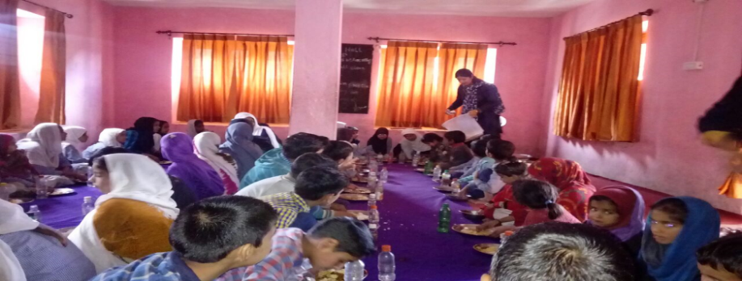
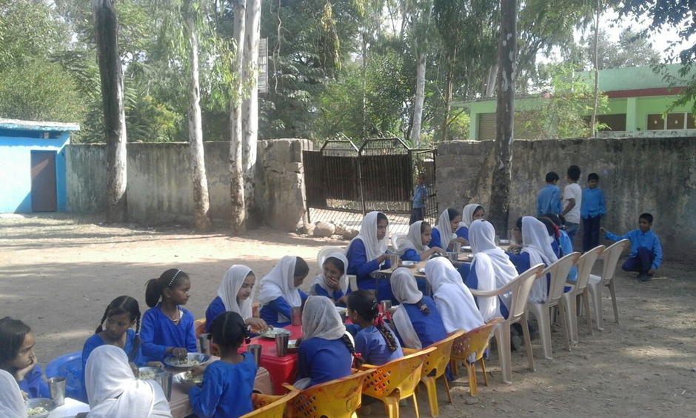
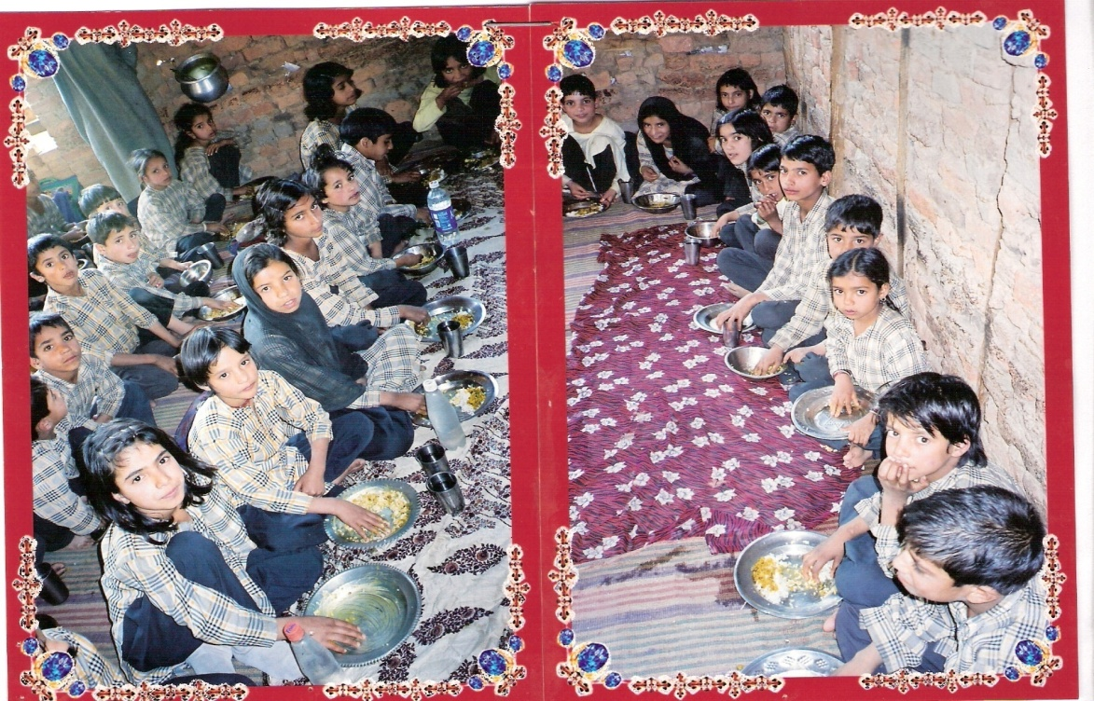
Government of Jammu & Kashmir
Mid Day Meal Scheme

Slide 2
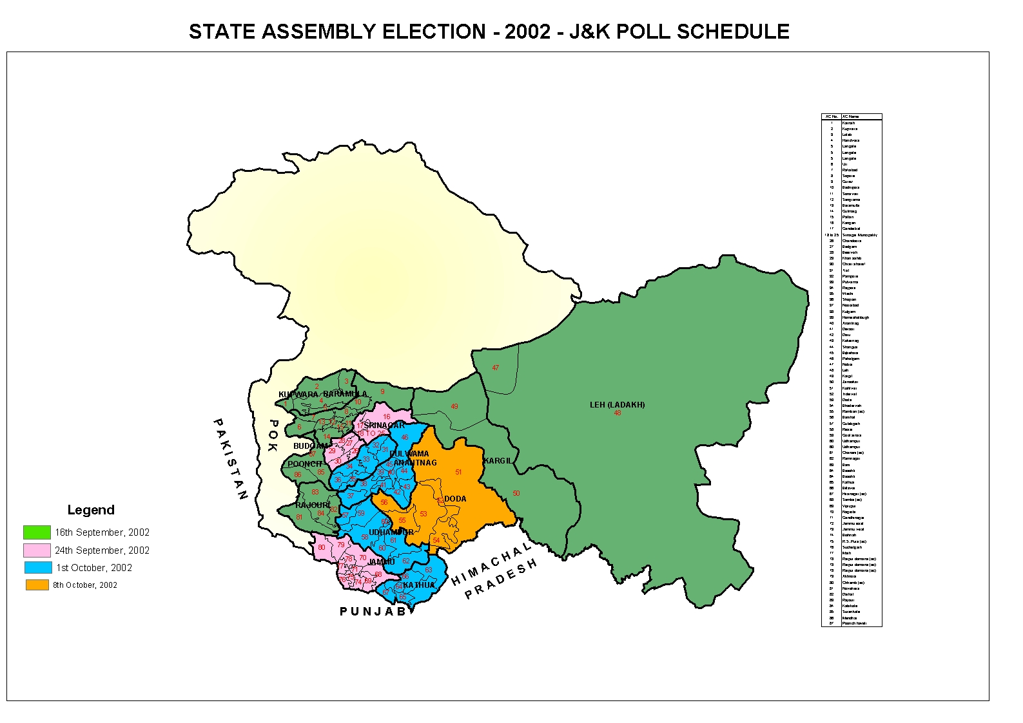
Jammu & Kashmir
Districts – 22 Educational Zones–201
Male Literacy: 78.26%
Female Literacy : 58.01%
Total Population = 1,25,48,926
Literacy rate as per census 2011 = 67.16 %

Slide 3
Management Structure
Administrative Secretary, SED
Mission Director MDM
Provincial JD, Kashmir
Provincial JD, Jammu
CEO
CEO
ZEO
ZEO
HoI
HoI

Slide 4
Approved AWP&B 2018-19
S.No. | Component | CS | SS | Total (Rs. in lacs) | Expenditure (In lacs)
1 | Cost of Food grain | 598.06 | 0 | 598.06 | 460.15
2 | Cooking Cost | 7404.57 | 820.19 | 8224.76 | 5386.95
3 | Honorarium to Cook-cum-Helper | 2994.12 | 332.68 | 3326.8 | 2859.24
4 | Transportation Assistance | 269.12 | 0 | 269.12 | 340.88
5 | MME | 202.76 | 0 | 202.76 | 153.34
6 | Kitchen Devices | 0 | 0 | 0 | 0
Total |  | 11468.63 | 1152.87 | 12621.5 | 9200.56 (73%)

Slide 5
School Health Programme (Rashtriya Bal Swasthya Karykram)
Salient Features:
Screening children from 6-18 years for 4 Ds:
Defects at birth (like cleft lip/palate, Downs syndrome etc)
Diseases (like scabies, eczema, dental condition, otitis media)
Deficiencies ( Anemia, vit A, D, goiter)
Development delays including disabilities (vision, hearing impairment, autism etc)

Slide 6
Rashtriya Bal Swasthya Karyakram (RBSK)
As per guidelines, the Chief Medical Officers has to constitute a mobile team of Health Officers including following:
Medical Officers (AYUSH) – 02 (01 male and 01 female)
ANM / Staff Nurse – 01
Pharmacist – 01
The health team has to visit a school at least once in a year.
After screening the health condition of the student, he / she is referred to nearby PHC / CHC.

Slide 7
RBSK Contd…..
Health Check (Children Covered) | Weekly Iron & Folic Acid Supplementation (WIFS) (Children Covered) | De-worming tablets distributed (Children Covered) | Distribution of spectacles
 |  |  | No. of children identified with refractive errors | No. of children provided with spectacles
756336 | 440137 | 496327 | 5674 | 2670

Slide 8
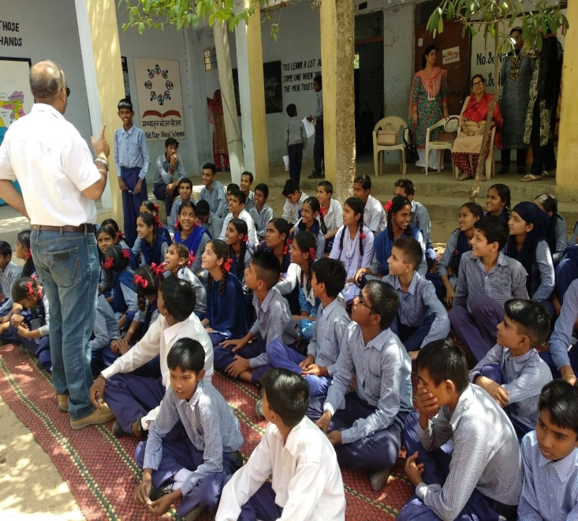
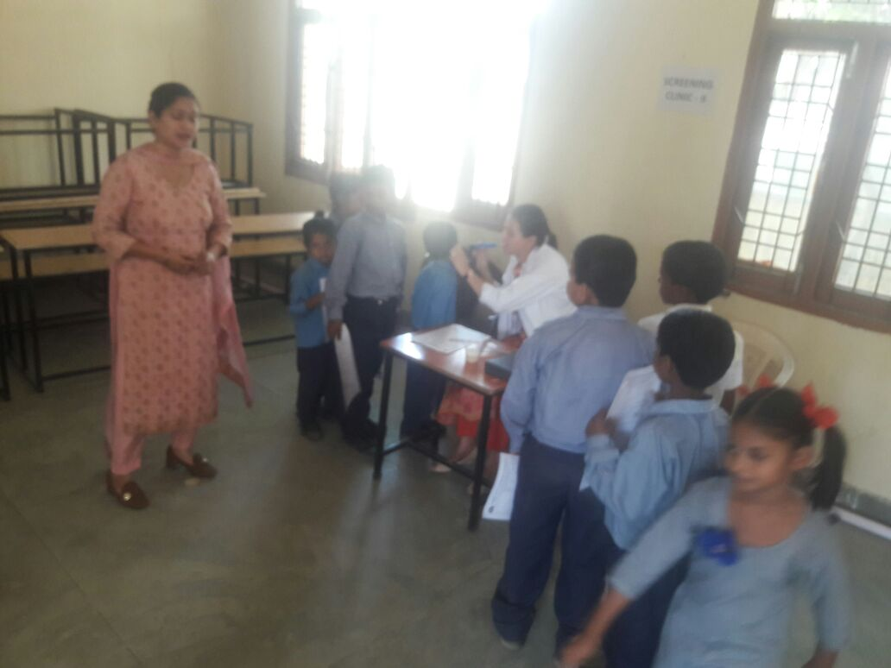
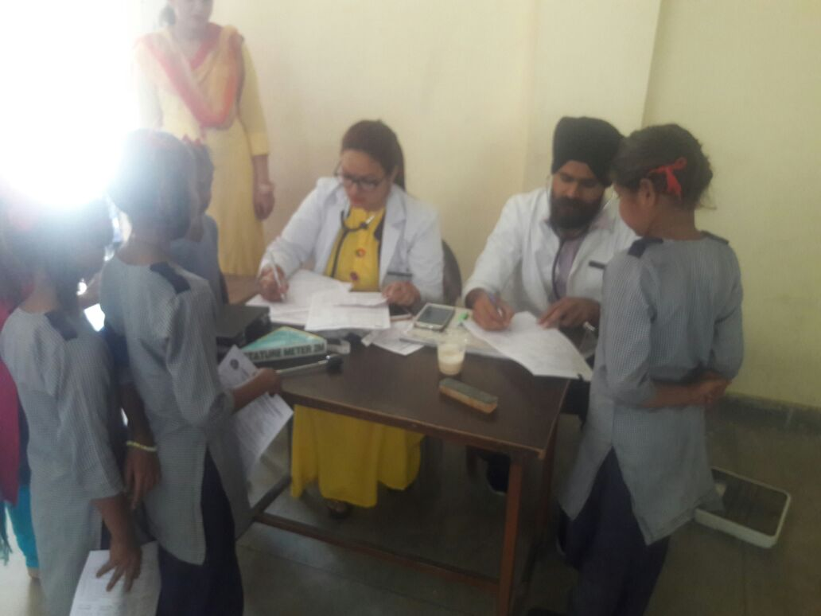
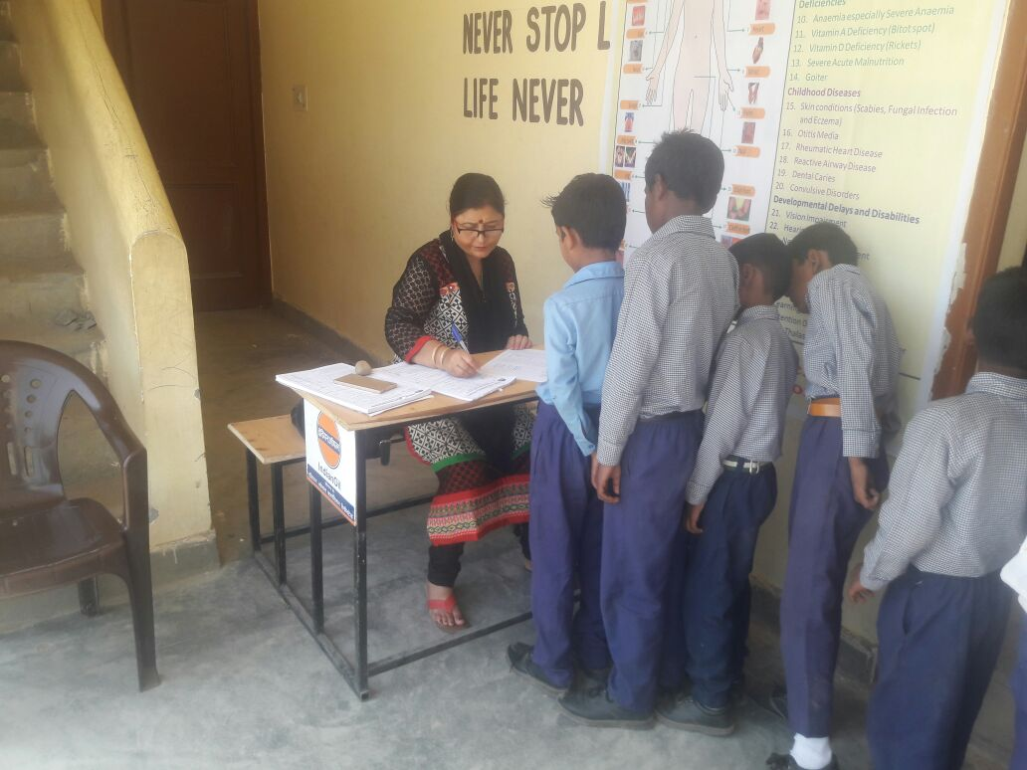
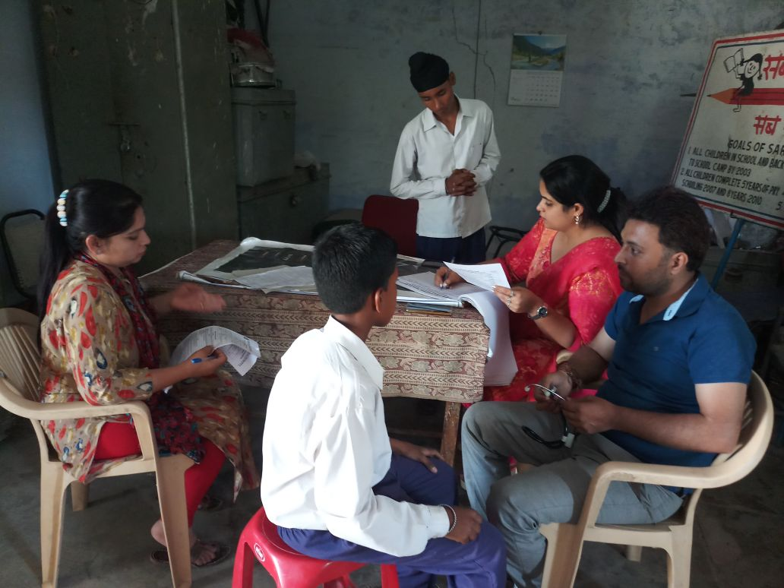
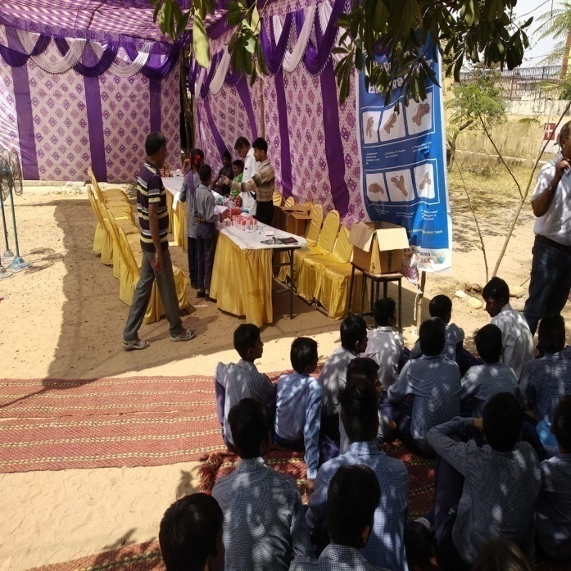
School Health Programme (Rashtriya Bal Swasthya Karykram)

Slide 9
STEPS TAKEN FOR IMPROVEMENT
TESTING:
Food samples tested from 506 schools by officials of Controller of Drugs and Food Control Organization, Jammu.
98 samples of ingredients taken; only 1 was found substandard
Training of cooks on Quality and Hygiene at:
Institute of Hotel Management, Rajbagh, Srinagar
Food Craft Institute, Nagrota, Jammu.
Kitchen Garden:
Kitchen gardens started for using fresh vegetables in the preparation of Mid-Day Meal in 201 schools.

Slide 10
Training of Cook Cum Helpers
Division | Master Trainer trained Till 31-03-2019 | CCH Trained by Master Trainer | Proposal for 2019-20
 |  |  | Master Trainer | CCH to be Trained by Master Trainer
Jammu | 174 | 1528 | 90 | 5000
Kashmir | 49 | 1263 | 90 | 5000
Total | 223 | 2791 | 180 | 10000

Slide 11
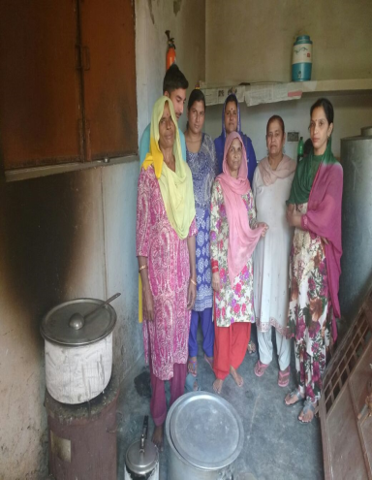
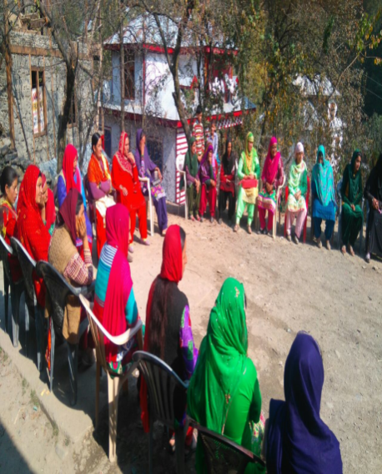
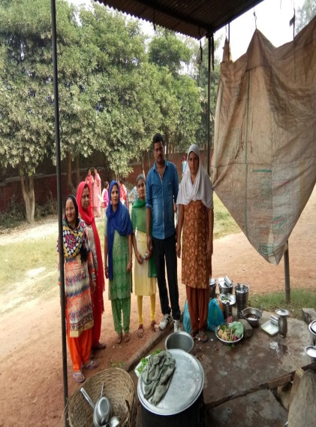
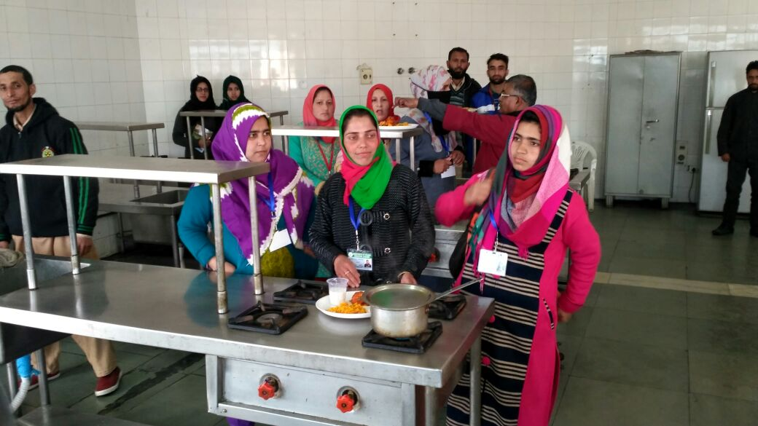
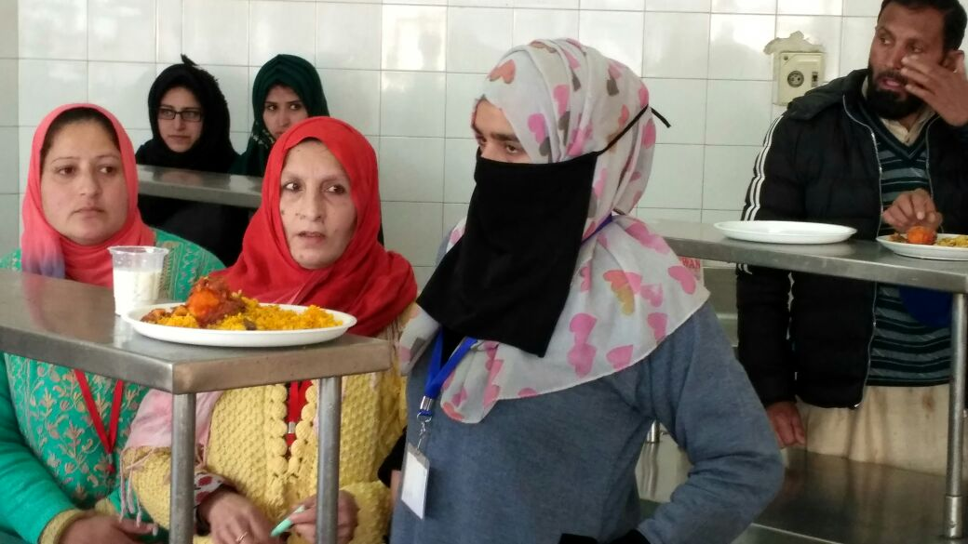
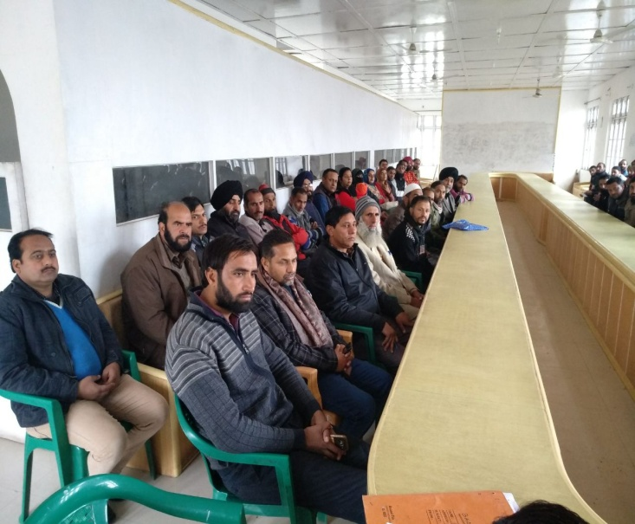
Training of Cook Cum Helpers

Slide 12
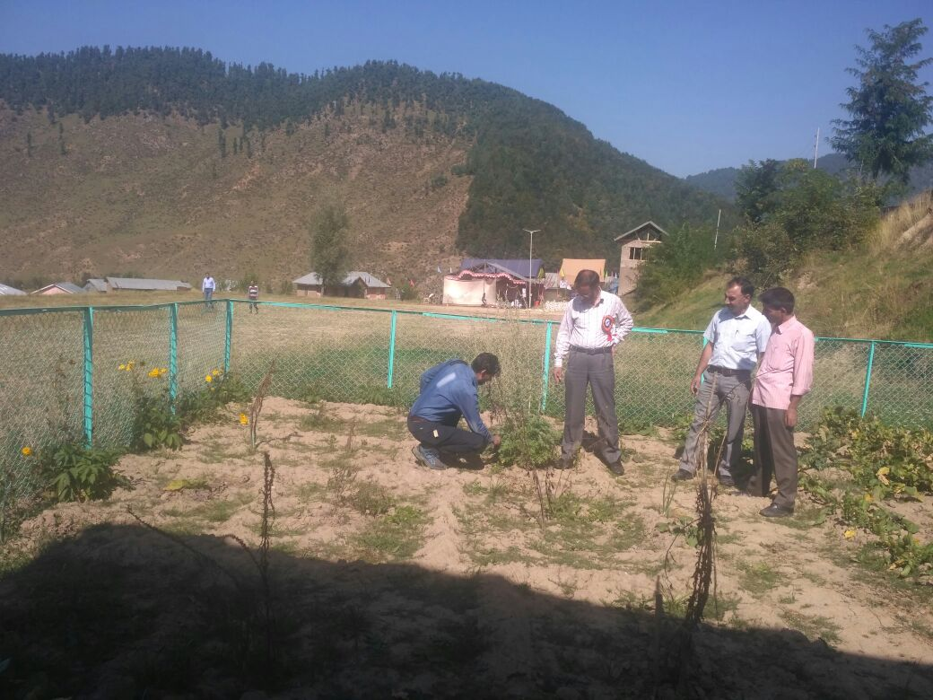
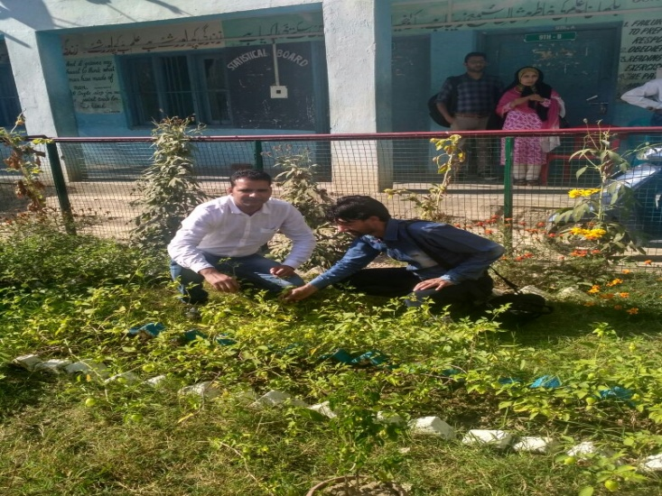
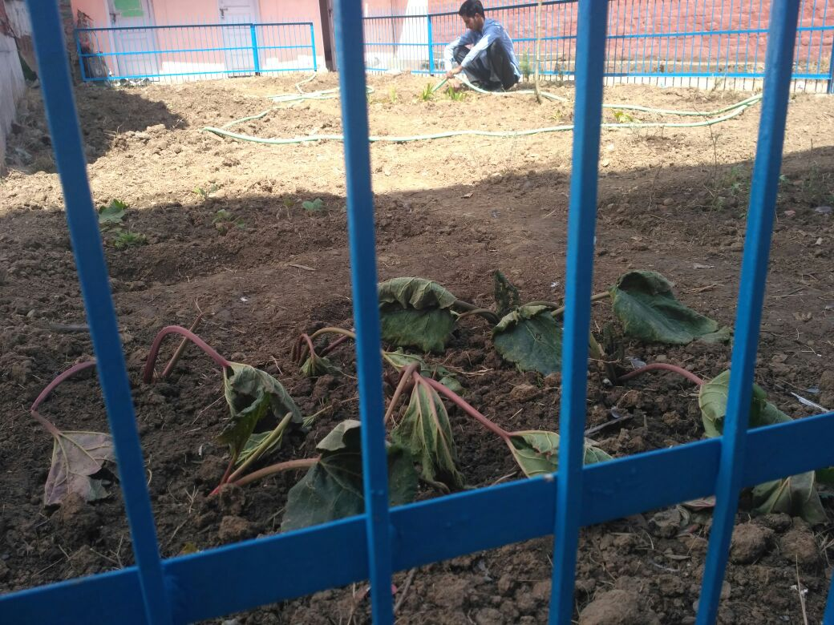
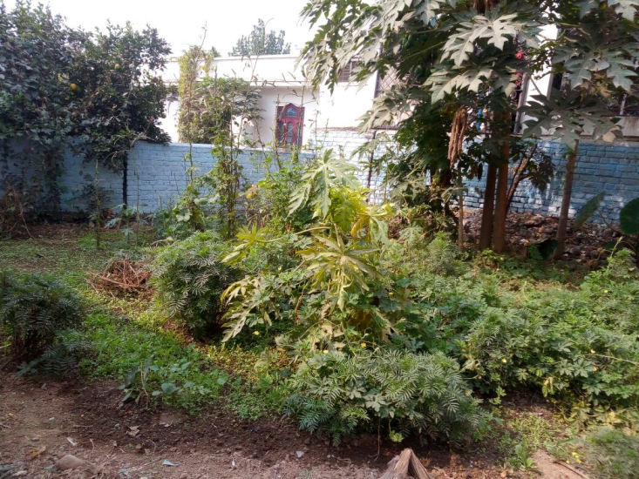
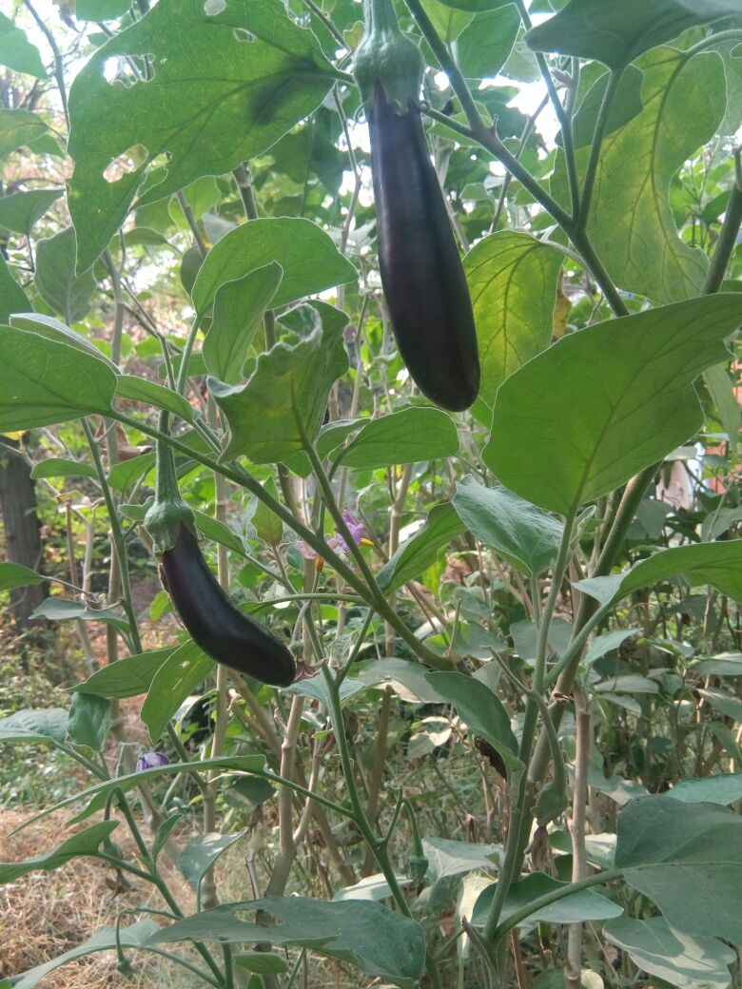
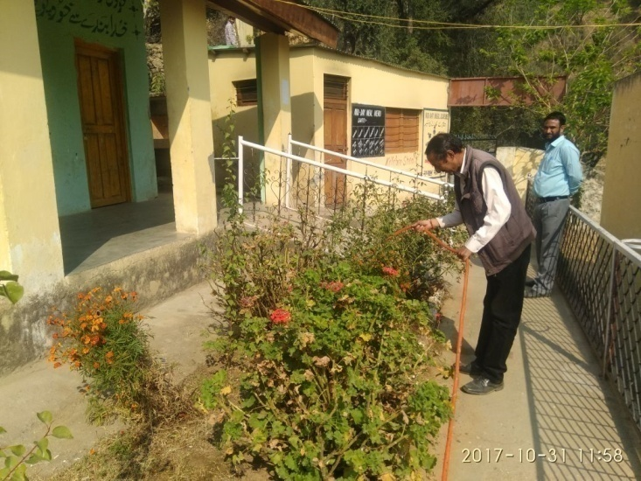
Kitchen Garden
201 schools have established Kitchen Gardens
GHSS Kulgam
HSS Beerwah Badgam
HSS Malvan
SS
MS Baryal Udhampur
MS Baranpata Jammu
HS Jodhpur Doda

Slide 13
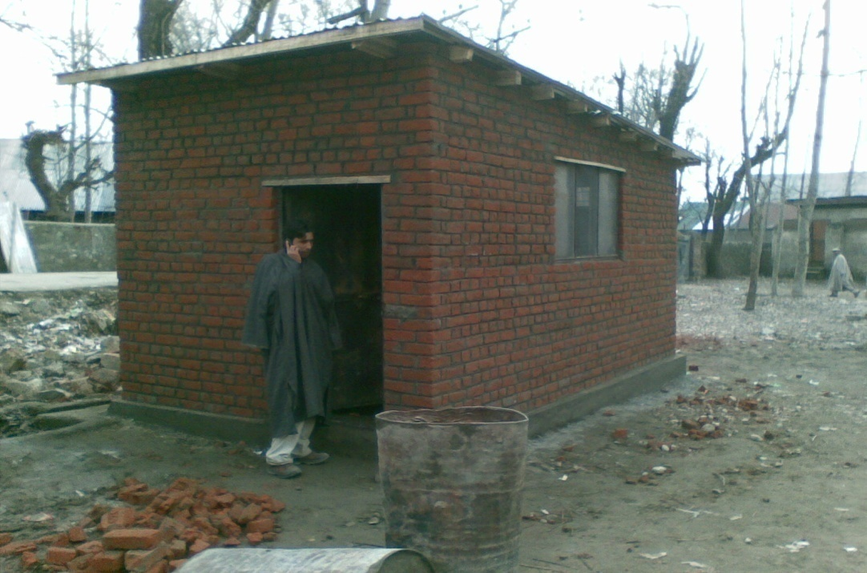
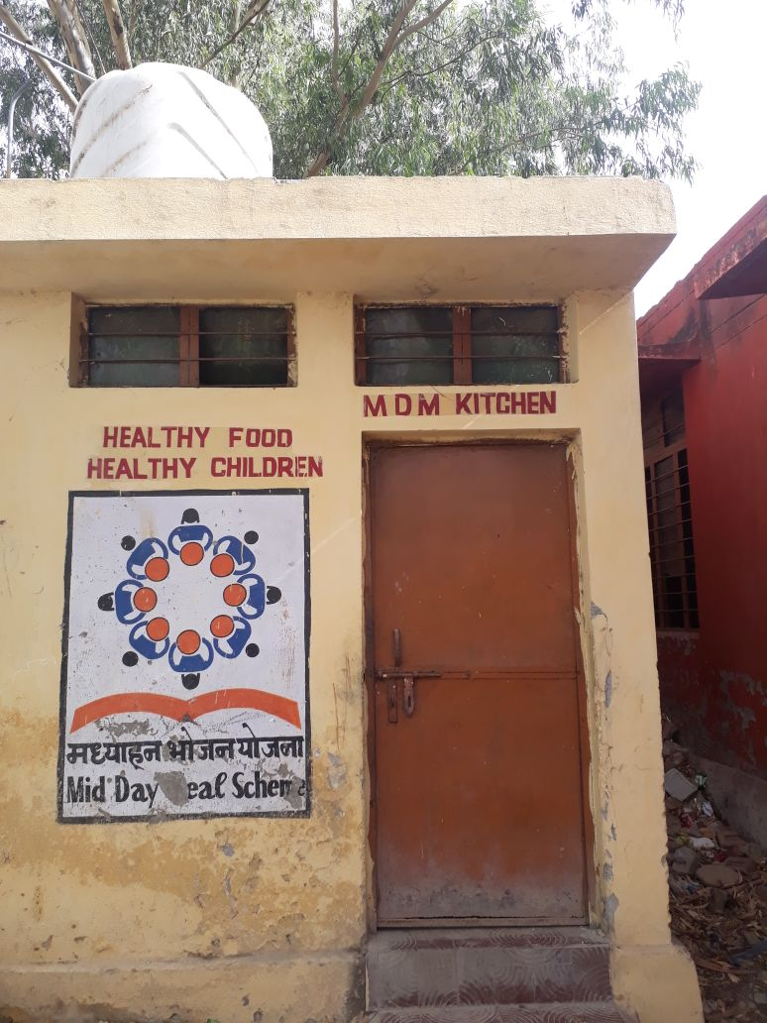
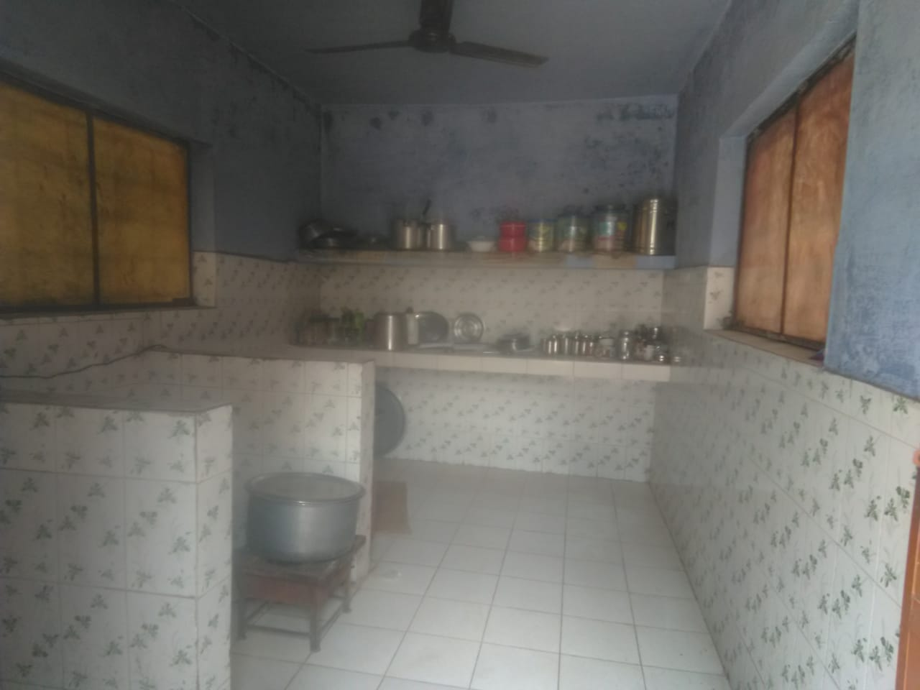
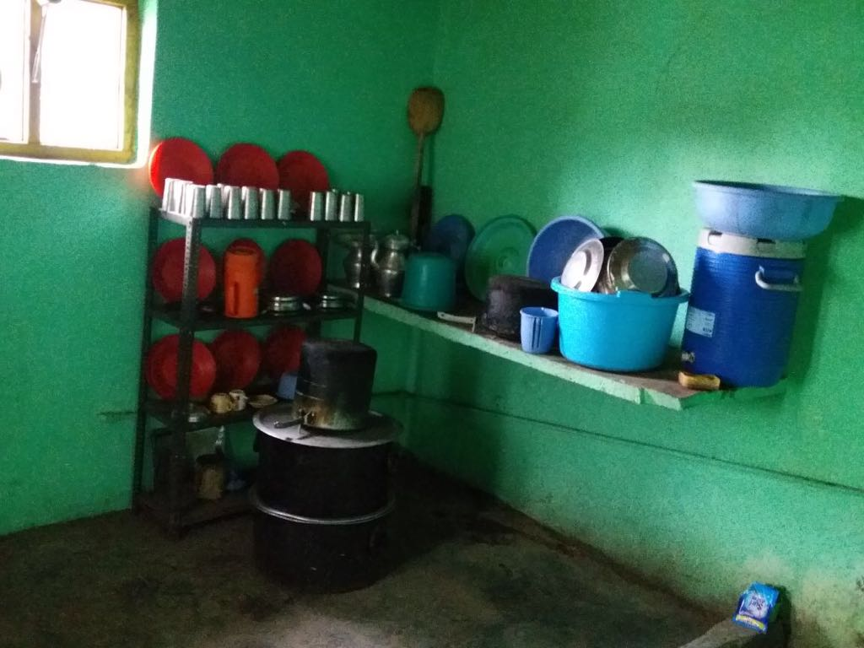
CONSTRUCTION OF KITCHEN CUM STORES

Slide 14
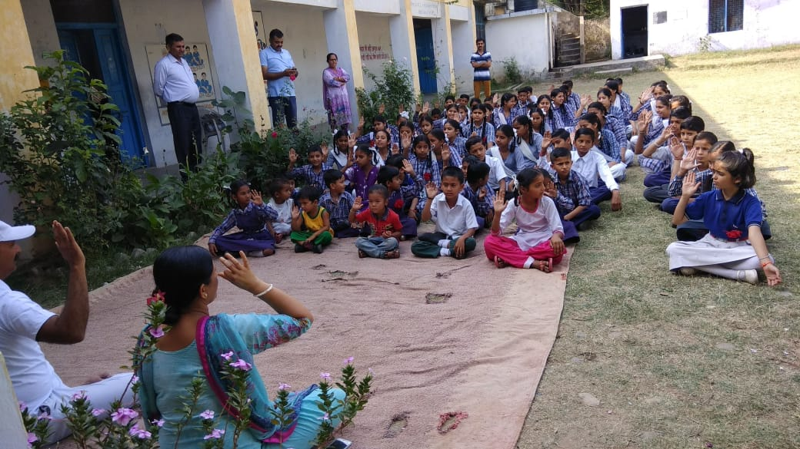
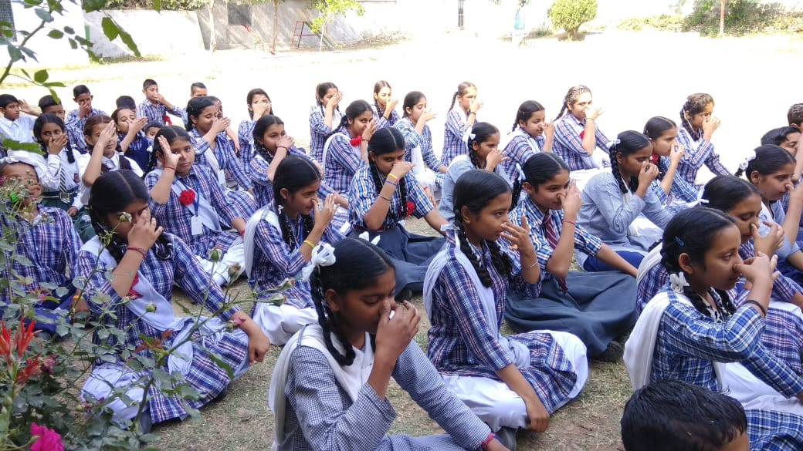
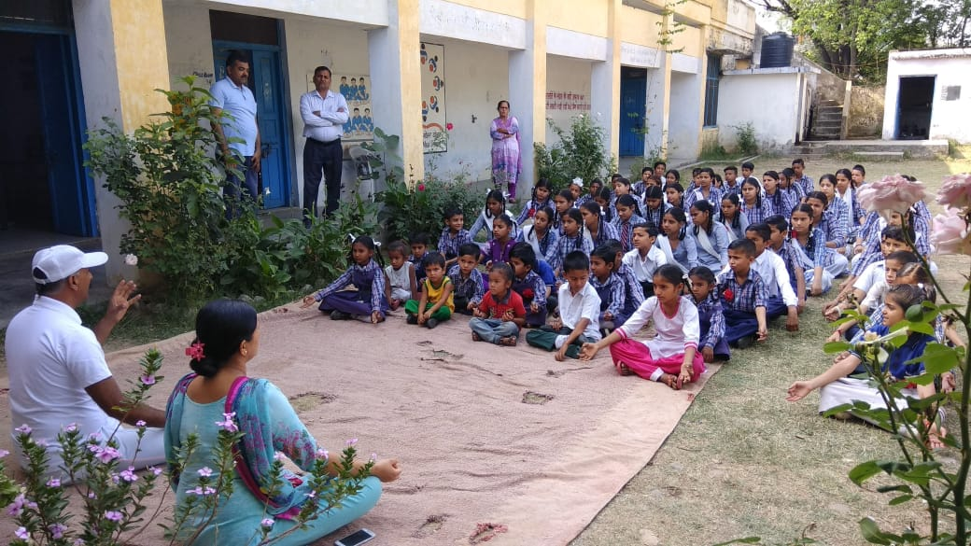
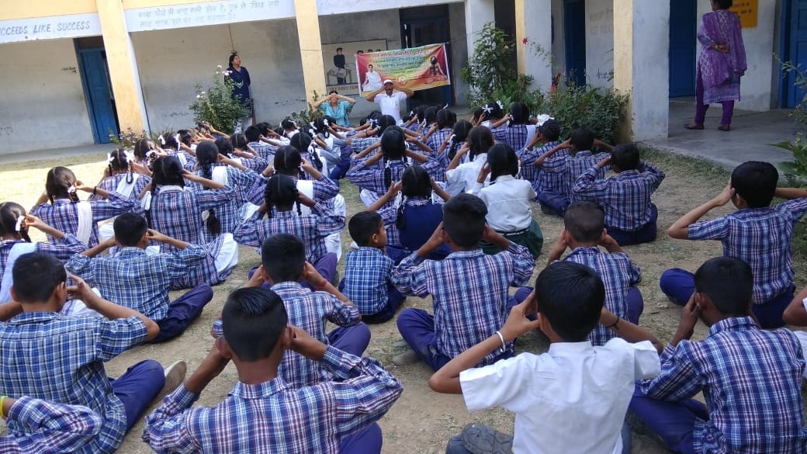
Yoga in Schools

Slide 15
Best Practices
Honorarium of cooks:
e-transfer of Honorarium into the bank account of CcHs
Monitoring:
5 meetings of District level committee headed by the senior most MP held during 2018-19.
199 Meetings of District Steering cum Monitoring Committee headed by Deputy Commissioner held during 2018-19.
16,401 Schools have been inspected by officials of School Education during 2018-19

Slide 16
Best Practices
Social Audit of the MDM scheme has been conducted in four Districts (Budgam, Ganderbal, Kathua and Ramban) through Department of Sociology of University of Jammu & and Department of Social Action of University of Kashmir.
Audit observations:
Children from different religions, caste and background sit together and take meals. It spreads amity and brotherhood.
Despite lesser man power in schools, meals are provided regularly .
Timely flow of funds is required at school level.
Lesser cost of cooking especially in hilly district of Ramban.

Slide 17
Best Practices
Akshay Patra, an NGO of national repute is being engaged for serving cooked meals from centralized kitchens to the schools in urban areas of districts of Jammu and Samba on pilot basis. Signing of the MoU for this purpose with the NGO is under process.
On-line daily Automated Reporting & Monitoring System (ARMS) developed by NIC-HP (www.mdmhp.nic.in) under MDM has been rolled out since Dec. 2017.

Slide 18
Initiatives proposed to be adopted
Tithi Bhojan | The community can serve food on special dates/ occasions like birthdays, marriage anniversaries etc to school children to either augment or substitute MDM on those days. This aims to foster community participation.
Media Mobilization | Use of Print Media, electronic Media and Radio for promotion of the MDM. AUD-20190226-WA0009 (1).mp3, AUD-20190226-WA0010 (1).mp3. Audios will be made in all regional languages.
Kitchen Gardens | About 4000 schools will be covered in the F.Y. 2019-20.
Poshan Abhiyan | Sensitization of children through Audio / Video material at school

Slide 19
Issues/Recommendations
Transportation Cost in hilly terrain involving head-load from fair price shop to school may be enhanced.
MDM for Kindergarten Classes:.
Children enrolled in Kindergarten are not presently covered in MDM scheme. They may be also be covered.
998 children have been enrolled in 48 schools in Jammu and 945 children in 54 schools in Kashmir Division.
However there is a proposal to start K.G. classes in all primary schools/facility

Slide 20
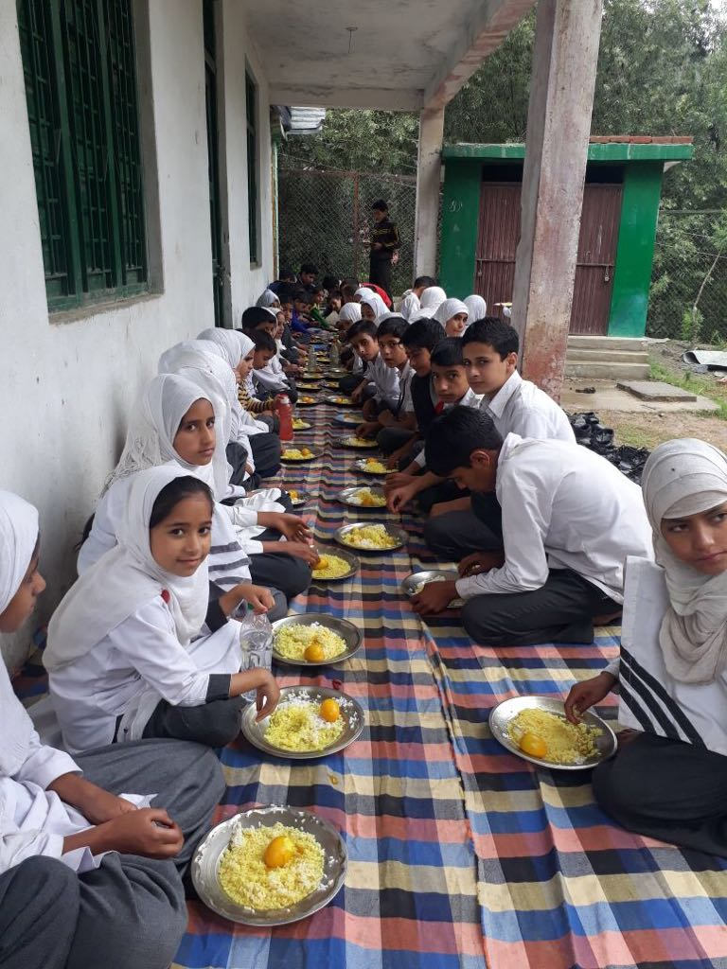
THANK YOU

